Slide 1

Real time DDOS Attack detection from Log Analysis using Deep Learning
Group No: A12

Slide 2





Supervisor
Co-Supervisor
Brig Gen Md Abdur Razzak, SUP, psc
Lec Raiyan Rahman
Thesis Members
Md. Abdul Al Emon [ 201914049 ]
Shad Reza [ 201914024 ]
Abdullah Al Masum [ 201914044 ]

Slide 3




Broad area of research

Slide 4
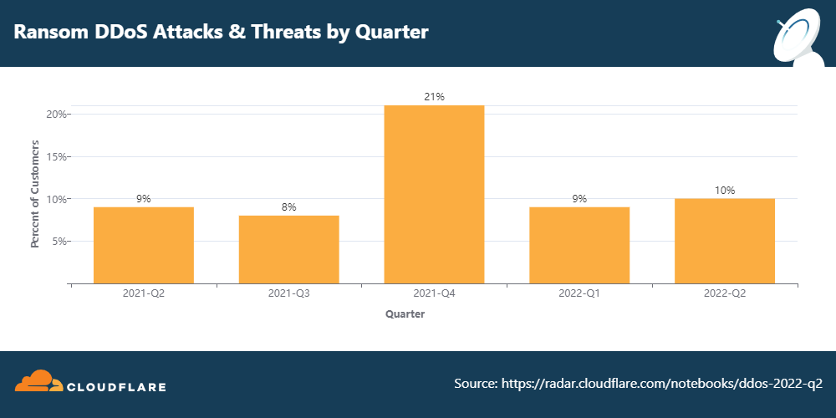
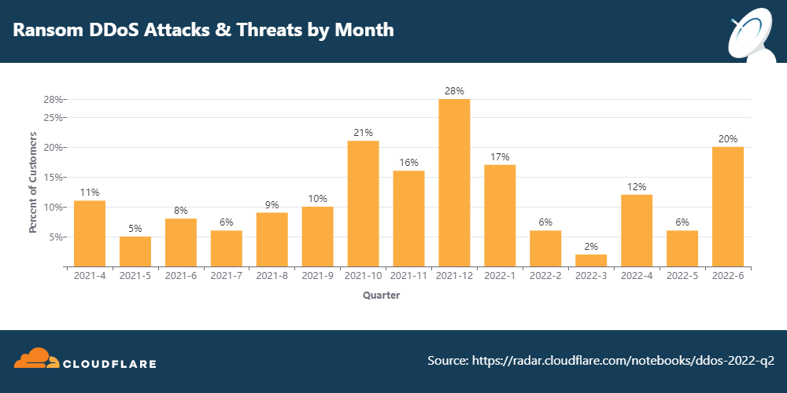
Introduction
According to the Cloudflare's 2022 Q2 DDoS threat landscape report DDoS attacks are on the rise
Ransom DDoS attacks reached an all-time high in June 2022,the Ukraine-Russia war provoked new attacks against broadcast media and banking companies and both application-layer and network-layer attacks rose by over 70% since 2021

Slide 5
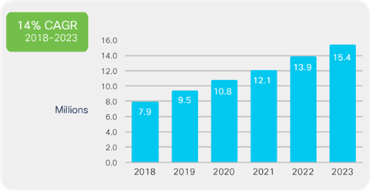
DDOS Attack Size and
Frequency Increasing
Peak attack size increased 63% YoY
776% growth in attacks between 100 Gbps and 400 Gbps YoY
Global frequency of DDoS attacks went up by 39% YoY
23% of the attacks greater than 1 Gbps
Average DDoS attacks size is 1 Gbps , enough to take most organizations completely offline
Number of DDoS Attacks will double to 15.4 million by 2023 globally
Source : Cisco Annual Internet Report (2018–2023)
Notes:
https://horizon.netscout.com/

Slide 6
Real-Time DDoS Attack Map

Slide 7
Why Choosing DDoS Attack?
Just like everything else in computing, DDoS attacks are evolving and becoming more destructive to business
Attack sizes are increasing, growing from 150 requests per second in the 1990s – which would bring a server of that era down – to the recent DYNDNS attack and GitHub attack at 1.2 TBs and 1.35 TBs respectively
The goal of these attacks was to disrupt major sources of productivity across the globe
These attacks used new techniques to achieve their huge bandwidth numbers

Slide 8
Objectives
Develop
Develop a Deep-Learning Model with bad request filtering and real-time prediction
Fabricate
Fabricate a standalone data visualization tool and dashboard for real-time monitoring
Compare
Compare accuracy of our model with existing models
Explore
Explore how additional data visualization can assist the analyst

Slide 9
Quick Overview of DDoS Attack

Slide 10





Server maintaining normal flow with regular clients

Slide 11

Arrival of Attacker

Slide 12
Attacker connects to the server

Slide 13

Attacker drawing the bandwidth of the server
Attacker starts to get a hold of the bandwidth
Server request processing capability being drained
Denial of Service for some regular Clients

Slide 14
Attacker accumulates most of the bandwidth
Regular Clients are unable to use the Server

Slide 15









How DDoS Attack can be formed
Single Hacker
Group of Hackers
Bot-Master with Slave-Bots

Slide 16




Process of making slave-bot
Random Host Machine

Slide 17
Slave Bot

Slide 19









Slide 23
Bot-Master can
Set the attack time
Set the duration of attack
Control the slave-bots through control server
Manipulate the infected hosts to overwhelm the victim server

Slide 24
Slave-Bots are
Infected host machines
Hosts rarely know / notice this infected state
Totally manipulated by the Bot-Master

Slide 25
DDoS

Slide 26
DDoS

Slide 27
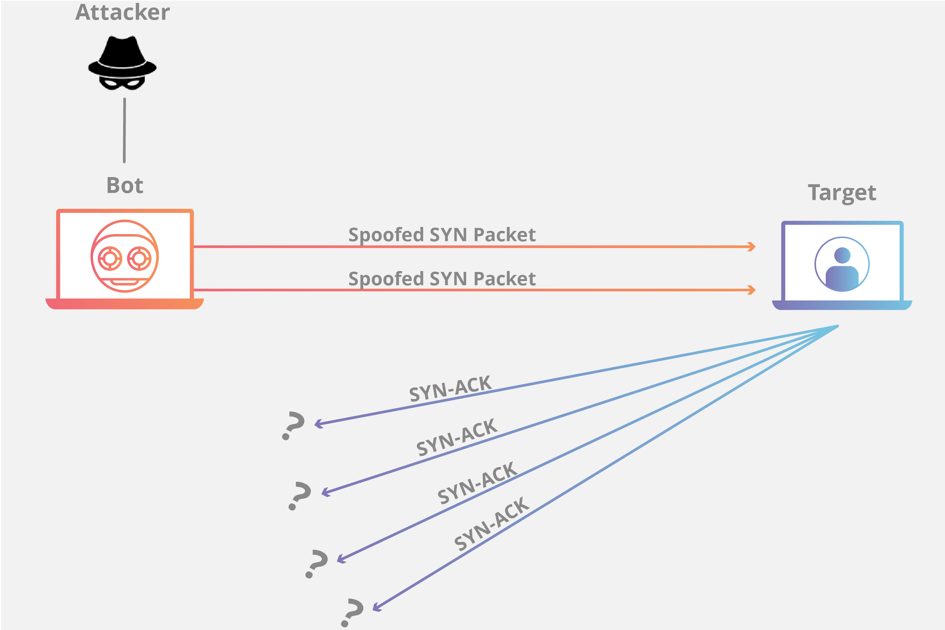
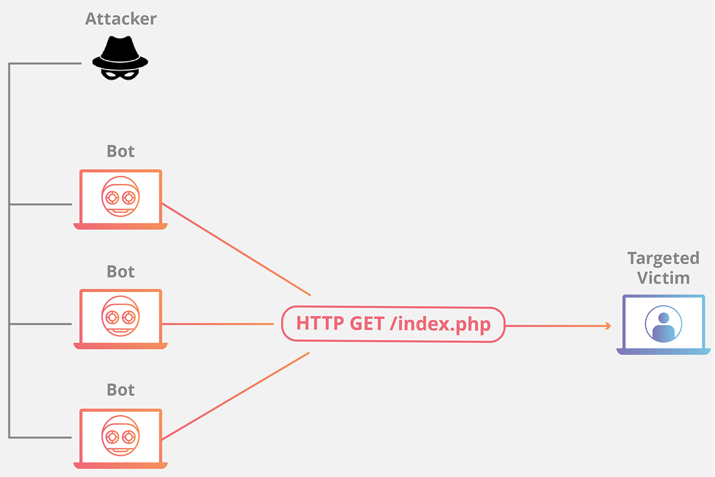
In general, DDoS attacks can be segregated by any layer of the Open Systems Interconnection (OSI) model they attack. They are most common at the Network (layer 3) and Application (Layer 7) Layers.
Fig: Network Layer DDoS Attack
Fig: Application Layer DDoS Attack
We will be working on the Application Layer

Slide 28

Literature Review

Slide 29
Ref | Paper Name | Brief on Dataset | Method/ Algorithm | Study Outcome
01 | LUCID: A Practical, Lightweight Deep Learning Solution for DDoS Attack Detection | ISCX2012 CIC2017 CSECIC2018 | network traffic preprocessing method CNN model architecture | They proposed online attack detection. And, it can reduce the processing time by 40X compared to its counterparts when deployed in a resource constrained environment. But, It requires a high retraining time to update the model’s weights and biases using new traffic samples, exposing the network to new DDoS attacks during this period
02 | DDoSNet: A Deep-Learning Model for Detecting Network Attacks | CICDDoS2019 | Deep Learning (DL) combining Recurrent Neural Network (RNN) with autoencoder & softmax regression layer | Their work focused on DDoS Detection in SDN environment They used autoencoder which is easy to train and does not require complex computation

Slide 30
Ref | Paper Name | Brief on Dataset | Method/ Algorithm | Study Outcome
03 | Towards Effective Detection of Recent DDoS Attacks: A Deep Learning Approach | CICDDoS2019 | Ensemble of feature selection based on a supervised feature ranking technique | They proposed a lightweight CyDDoS Intrusion Detection System. Their proposed model is trained in 5 seconds, reducing 88% of features from the original dataset while providing a detection performance superior to 99.6% in most considered metrics.
04 | Feature Selection Evaluation towards a Lightweight Deep Learning DDoS Detector | ISCXIDS 2012 CICIDS 2017 CSE-CICIDS 2018 CICDDoS2019 | Feature reduction approach Analysis of Variance (ANOVA) a statistical method | This work aims to identify and use only the needed input data for the detection of DDoS attacks by using ANOVA They proposed input data can be reduced up to 84.21% while only reducing 0.1% detection accuracy.

Slide 31
Ref | Paper Name | Brief on Dataset | Method/ Algorithm | Study Outcome
05 | WEB DDoS Attack Detection Method Based on Semi-supervised Learning | NSL-KDD | Semi-supervised learning model combining spectral clustering and random forest Data preprocessed using five-fold cross-validation method | Supervisory methods cannot handle large amount of network traffic data, and the performance is often limited by noise and irrelevant data Unsupervised methods generally have a high false positive rate They proposed a web application layer DDoS attack detection using semi-supervised
06 | Deep discover: Deep learning models for detecting distributed denial of service (DDOS) attacks | CICIDS2017 CICDDoS2019 | MinMax Scalar for pre-processing SoftMax is used for multiclass classification with DNN RNN using LSTM | The dimension of the final layer is equal to the number of classes in DNN They proposed higher accuracy for testing dataset using LSTM

Slide 32

Proposed Methodology

Slide 33
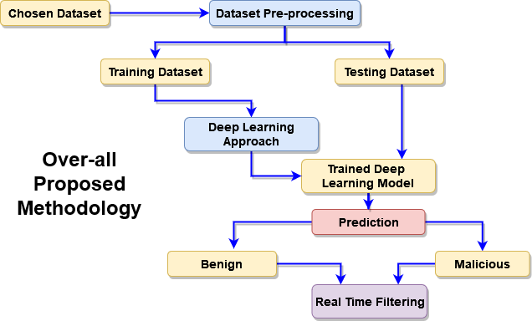

Slide 34
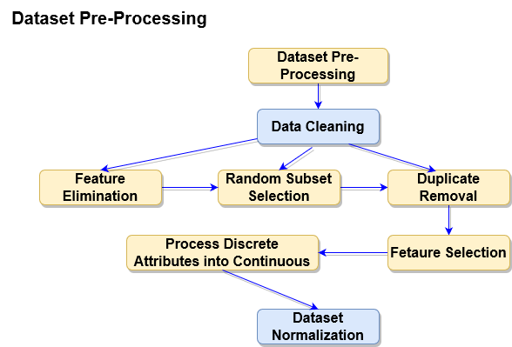

Slide 35
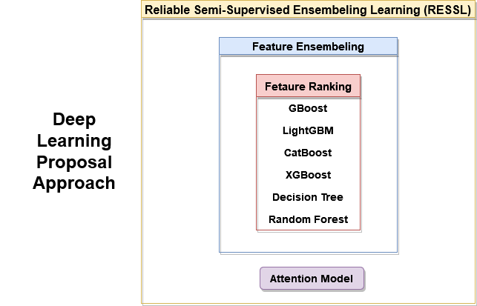

Slide 36
Why we are proposing Log File Analysis?
Log analysis is the process of reviewing computer-generated event logs to proactively identify bugs, security threats, factors affecting system or application performance, or other risks
From a security point of view, the purpose of a log is to act as a red flag when something bad is happening
Reviewing logs regularly could help identify malicious attacks on system
Given the large of amount of log data generated by systems, it is impractical to review all of these logs manually each day

Slide 37
Why we are proposing Deep Learning ?
Drawbacks of ML
Classical ML classifications have difficulties to work with a large amount of data due to its limited ability in feature learning.
The false alarm is significantly high when the amount of data becomes extremely large
Advantages of DL
With deep learning, feature extraction and modeling steps are automatically performed after data training while machine learning requires data manually extracting and creating features.

Slide 38
Why we are proposing Ensembeling Approach?
Background
Each time a neural network model is trained, it may learn a slightly (or dramatically) different version of the mapping function from inputs to outputs, that in turn will have different performance on the training and holdout datasets. which can be frustrating when preparing a final model for making predictions.
Advantages
Ensemble learning combines the predictions from multiple neural network models to reduce the variance of predictions and reduce generalization error.
The idea is to combine the predictions from multiple good but different models.

Slide 39
Why we are proposing Attention Model in Deep Learning?
Background
RNNs cannot remember longer sentences and sequences due to the vanishing/exploding gradient problem
Also, LSTM becomes forgetful in specific cases.
Another problem is that there is no way to give more importance to some of the input words compared to others
Advantages
Each time the model predicts an output word, it only uses parts of the input where the most relevant information is concentrated instead of the entire sequence. In simpler words
This helps the model to cope efficiently with long input sentences.

Slide 40
Progress we have done

Slide 41
Progress using Machine Learning Approach (so far)
CICDDoS-2018 N = 572
Dataset Chosen
Data Cleanup/Filtering
Custom Labelling
Cross Checking
Data Pre-processing
Training
Test
Dataset Split to Training and Test (80% to 20%)
Support Vector Machine (SVM)
K Nearest Neighbours (KNN)
Decision Tree
Train the Models
Compare Results

Slide 42
Progress using Machine Learning Approach
SVM Implementation Python Notebook
KNN Implementation Python Notebook
Decision Tree Implementation Python Notebook

Slide 43
Dataset Analysis
The dataset was collected from Canadian Institute for Cybersecurity
The dataset contains about 80 features
Have 113 thousand normal traffic samples and over 70 million malicious flows, distributed over 13 classes of recent DDoS attacks
CICDDoS2019

Slide 44

How will our work help the Cyber Security Analyst?
Help
Alert
Block
Assist
Our Real-time approach will help the online sites maintain a more secure uptime with greater means of availability
The automated notification system will alert the administrative authority about the attack
The detection system will block the corrupted IPs, get a hold of their behavioral stats, report to the admin panel, and maintain the normal flow of the overall process of the site
This real-time detection module will assist the cyber specialist and the analyst in the behavior of DDoS attacks and the overall findings of the attacks

Slide 45
References
[1] R. Doriguzzi-Corin, S. Millar, S. Scott-Hayward, J. Martínez-del-Rincón and D. Siracusa, "Lucid: A Practical, Lightweight Deep Learning Solution for DDoS Attack Detection," in IEEE Transactions on Network and Service Management, vol. 17, no. 2, pp. 876-889, June 2020, doi: 10.1109/TNSM.2020.2971776.
[2] M. S. Elsayed, N. -A. Le-Khac, S. Dev and A. D. Jurcut, "DDoSNet: A Deep-Learning Model for Detecting Network Attacks," 2020 IEEE 21st International Symposium on "A World of Wireless, Mobile and Multimedia Networks" (WoWMoM), 2020, pp. 391-396, doi: 10.1109/WoWMoM49955.2020.00072.
[3] Ivandro Ortet Lopes, Deqing Zou, Francis A Ruambo, Saeed Akbar, Bin Yuan, "Towards Effective Detection of Recent DDoS Attacks: A Deep Learning Approach", Security and Communication Networks, vol. 2021, Article ID 5710028, 14 pages, 2021. https://doi.org/10.1155/2021/5710028
[4] O. R. Sanchez, M. Repetto, A. Carrega, R. Bolla and J. F. Pajo, "Feature Selection Evaluation towards a Lightweight Deep Learning DDoS Detector," ICC 2021 - IEEE International Conference on Communications, 2021, pp. 1-6, doi: 10.1109/ICC42927.2021.9500458.

Slide 46
References
[5] Xiang Yu, Wenchao Yu, Shudong Li, Xianfei Yang, Ying Chen, Hui Lu, and Zhili Zhou. 2021. WEB DDoS Attack Detection Method Based on Semisupervised Learning. Sec. and Commun. Netw. 2021 (2021). https://doi.org/10.1155/2021/9534016
[6] S. Malliga, S. V. Kogilavani, and R. Sowmya , "Deep discover: Deep learning models for detecting distributed denial of service (DDOS) attacks", AIP Conference Proceedings 2393, 020191 (2022) https://doi.org/10.1063/5.0074445
[8] Cisco Annual Internet Report (2018–2023) [Link]
[7] DDoS attack trends for 2022 Q2 [Link]

Slide 47

THANK YOU

